Slide 1


Mobile Programming Project 1
Made by :
Faruk Abdullahi 210218333
Tan Emre Kar 220218500
Mert Eren Dilsiz 200218033
Ahmad Jabari 210218337

Slide 2
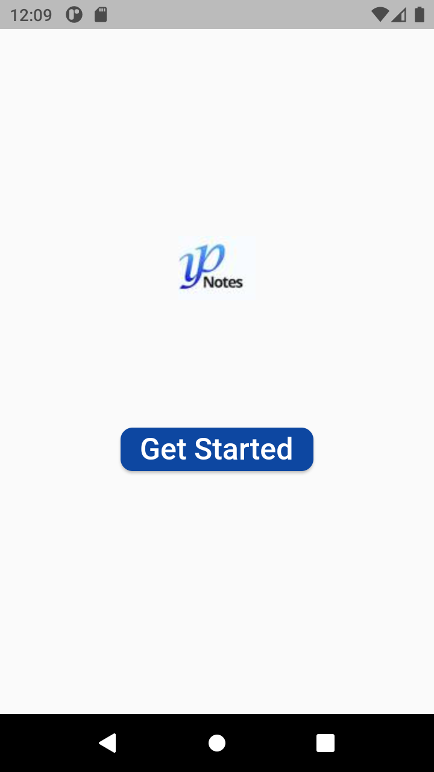

Slide 3
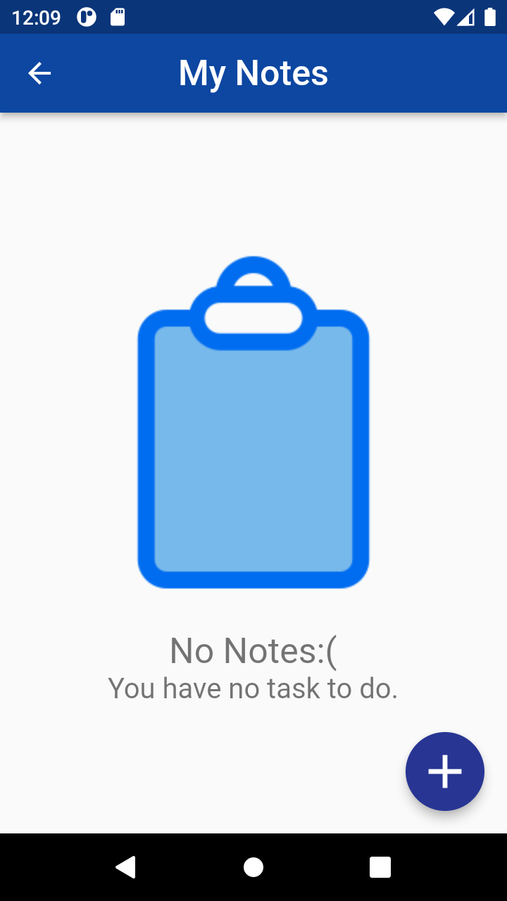

Slide 4
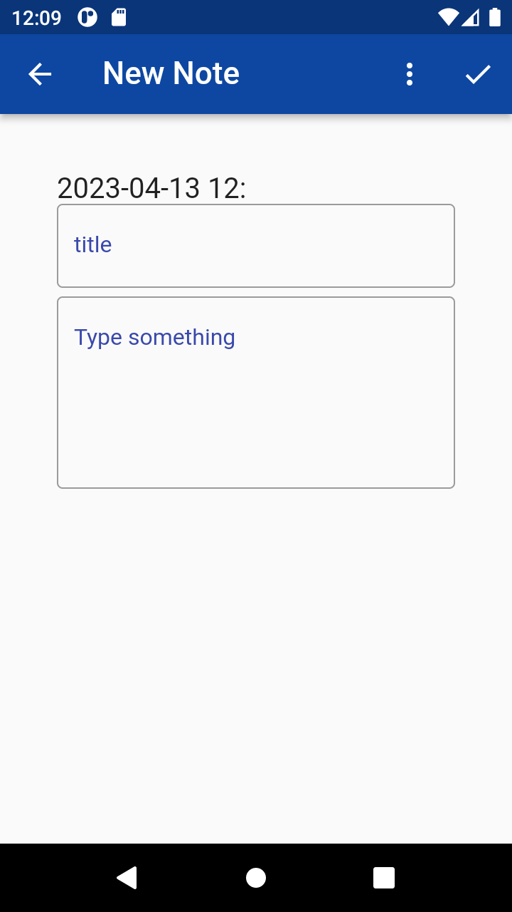
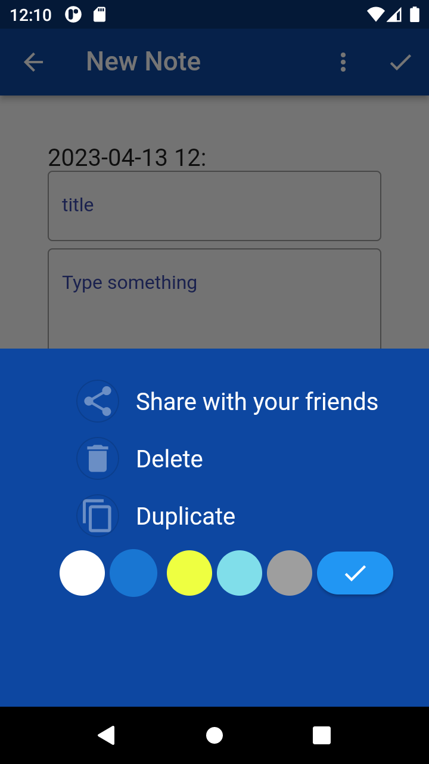

Slide 5
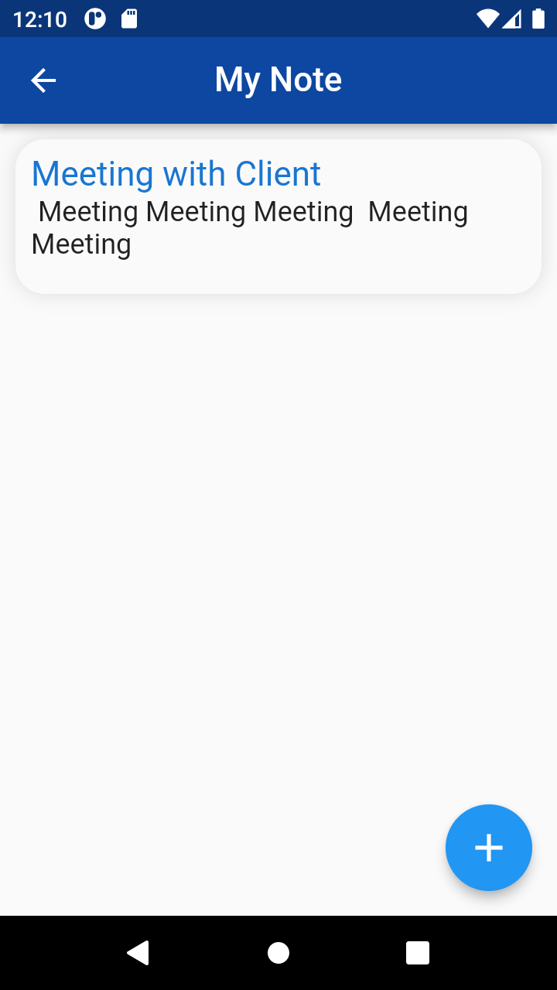
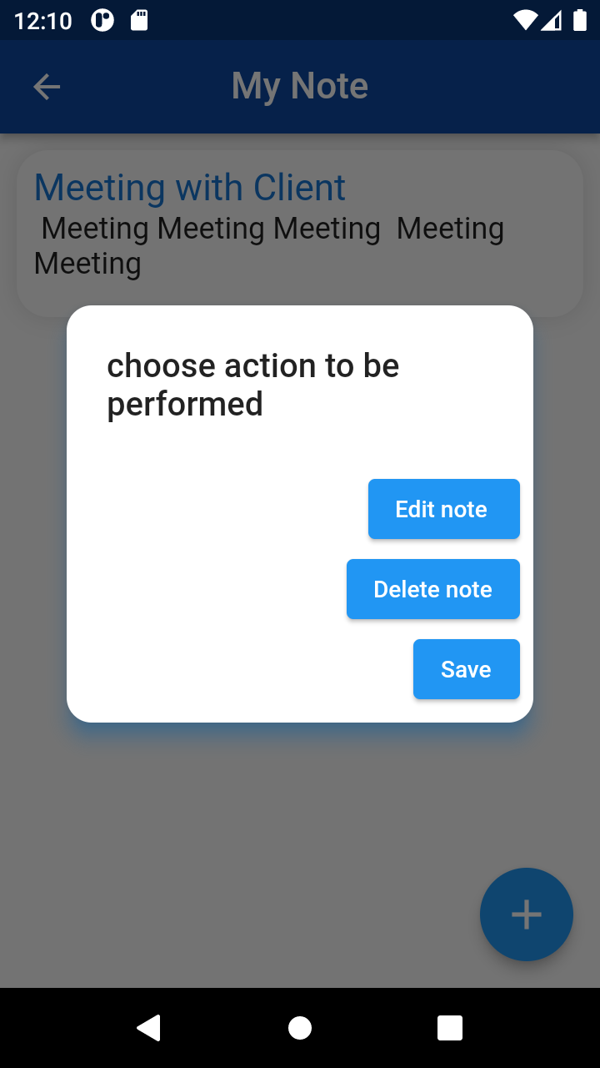

Slide 6
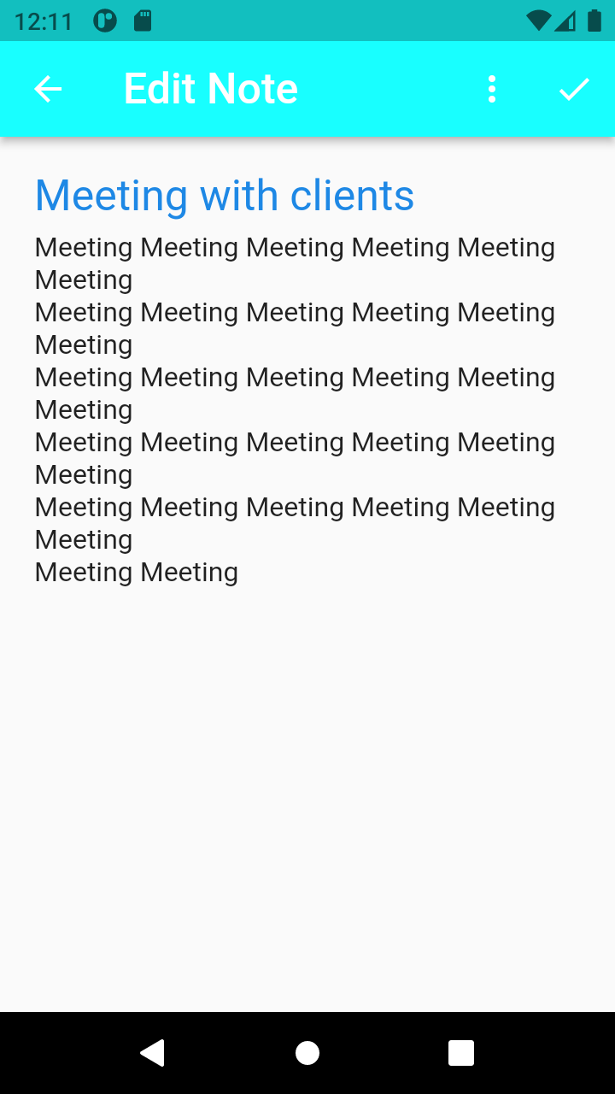
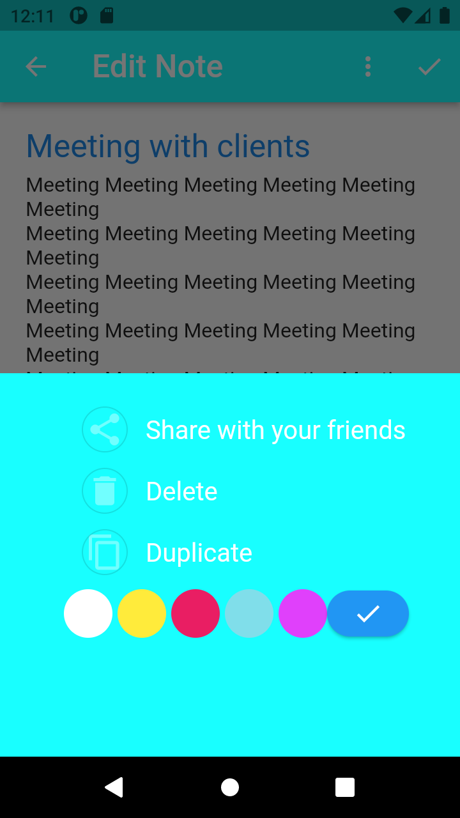

Slide 7
Thank You For Listening our presentation.

